Slide 1
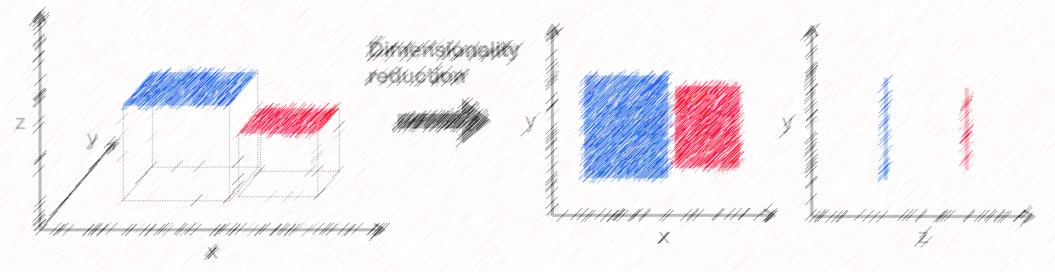

Lecture 12: Dimensionality Reduction
CSE445 Machine Learning
Dr. Jilan Samiuddin (JSA)
Assistant Professor
North South University

Slide 2
Linear Algebra Review

Slide 3
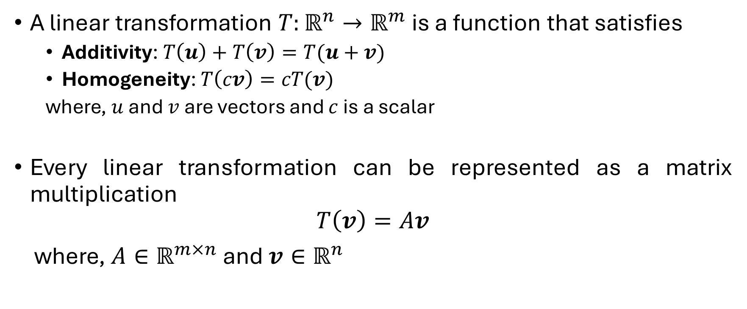
Linear Transformation
A linear transformation $T:ℝ^{n}→ℝ^{m}$ is a function that satisfies
Additivity: $T\left(u\right)+T\left(v\right)=T(u+v)$
Homogeneity: $T\left(cv\right)=cT(v)$
where, $u$ and $v$ are vectors and $c$ is a scalar
Every linear transformation can be represented as a matrix multiplication
$$T\left(v\right)=Av$$
where, $A∈ℝ^{m×n}$ and $v∈ℝ^{n}$

Slide 4
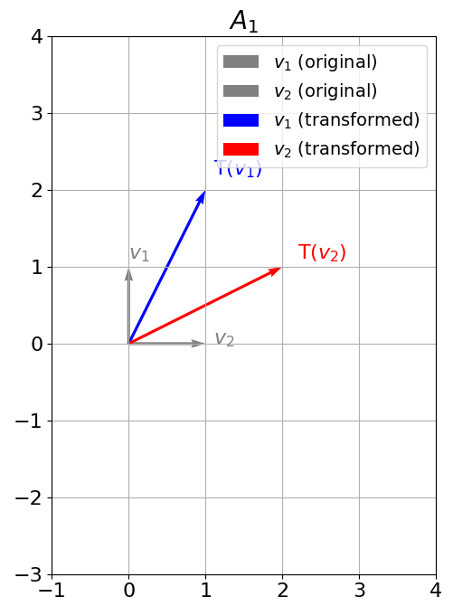
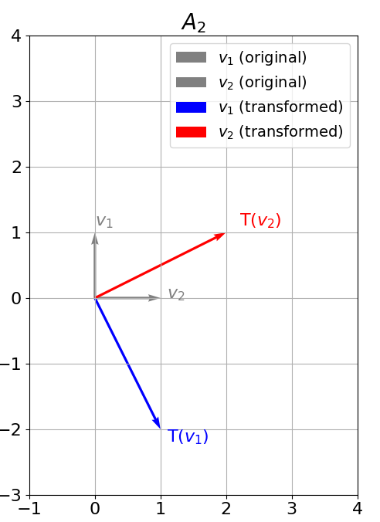

Linear Transformation (contd.)
Consider two square matrices:
$A_{1}=\left[\begin{matrix}2 & 1 \\ 1 & 2\end{matrix}\right]$ and, $A_{2}=\left[\begin{matrix}2 & 1 \\ 1 & −2\end{matrix}\right]$
If we apply them on $v_{1}=\left[\begin{matrix}0 \\ 1\end{matrix}\right]$ and $v_{2}=\left[\begin{matrix}1 \\ 0\end{matrix}\right]$:
$A_{1}v_{1}=\left[\begin{matrix}2 & 1 \\ 1 & 2\end{matrix}\right]\left[\begin{matrix}0 \\ 1\end{matrix}\right]=\left[\begin{matrix}1 \\ 2\end{matrix}\right]$
$A_{1}v_{2}=\left[\begin{matrix}2 & 1 \\ 1 & 2\end{matrix}\right]\left[\begin{matrix}1 \\ 0\end{matrix}\right]=\left[\begin{matrix}2 \\ 1\end{matrix}\right]$
$A_{2}v_{1}=\left[\begin{matrix}2 & 1 \\ 1 & −2\end{matrix}\right]\left[\begin{matrix}0 \\ 1\end{matrix}\right]=\left[\begin{matrix}1 \\ −2\end{matrix}\right]$
$A_{2}v_{2}=\left[\begin{matrix}2 & 1 \\ 1 & −2\end{matrix}\right]\left[\begin{matrix}1 \\ 0\end{matrix}\right]=\left[\begin{matrix}2 \\ 1\end{matrix}\right]$

Slide 5
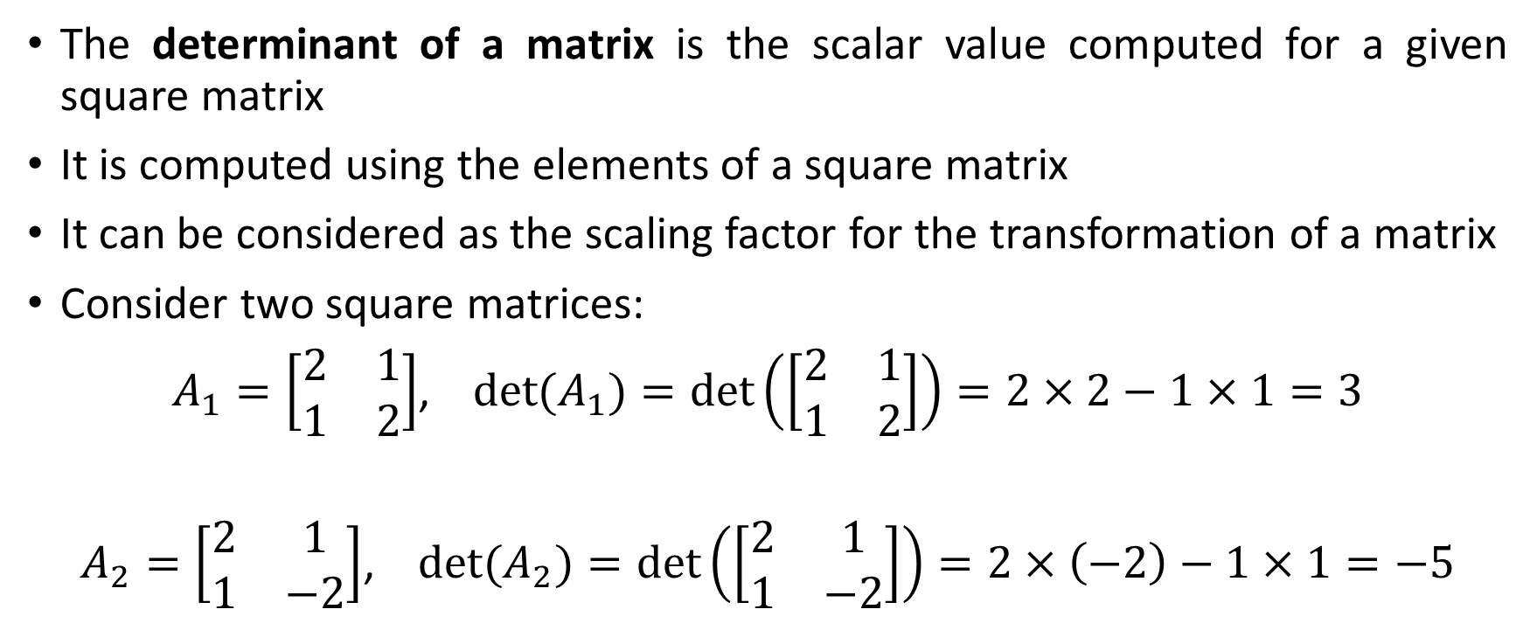
Determinant
The determinant of a matrix is the scalar value computed for a given square matrix
It is computed using the elements of a square matrix
It can be considered as the scaling factor for the transformation of a matrix
Consider two square matrices:
$A_{1}=\left[\begin{matrix}2 & 1 \\ 1 & 2\end{matrix}\right]$, $\det{(A_{1})}=\det\left(\left[\begin{matrix}2 & 1 \\ 1 & 2\end{matrix}\right]\right)=2×2−1×1=3$
$A_{2}=\left[\begin{matrix}2 & 1 \\ 1 & −2\end{matrix}\right]$, $\det{(A_{2})}=\det\left(\left[\begin{matrix}2 & 1 \\ 1 & −2\end{matrix}\right]\right)=2×\left(−2\right)−1×1=−5$

Slide 6
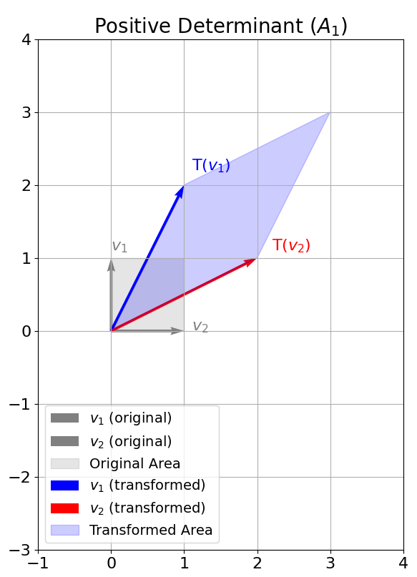
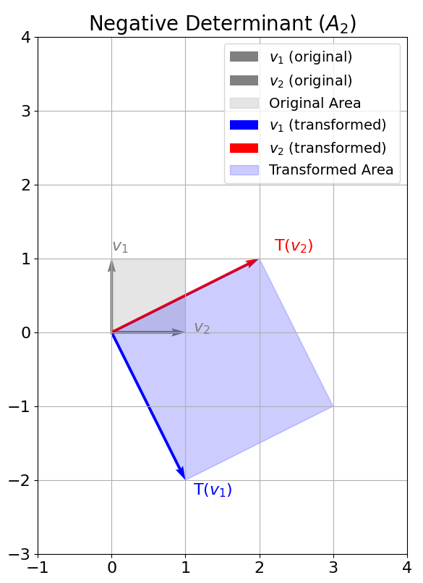

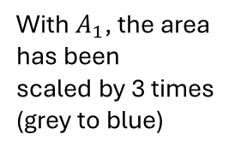
Determinant (contd.)
Determinant represents the factor by which the area has been scaled
With $A_{2}$, the area has been
scaled by 5 times (grey to blue). However, the negative sign represents how the orientation has been inverted.
Note: $v_{2}$ was to the right of $v_{1}$ before transformation but afterwards, $v_{2}$ is to the left of $v_{1}$
With $A_{1}$, the area has been
scaled by 3 times (grey to blue)

Slide 7
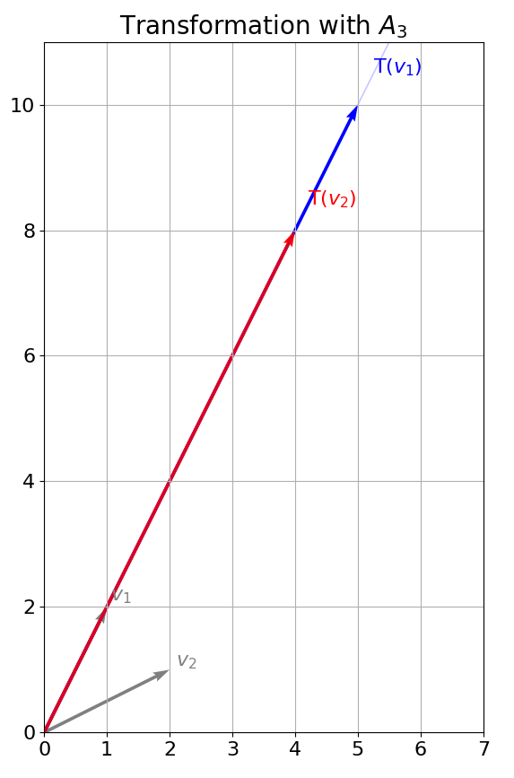


Determinant (contd.)
If we used a matrix $A_{3}=\left[\begin{matrix}1 & 0 \\ 1 & 0\end{matrix}\right]$ that has $\det{(A_{3})}=\det\left(\left[\begin{matrix}1 & 0 \\ 1 & 0\end{matrix}\right]\right)=0$, the new area would be zero, i.e., the transformation flattens all vectors into a line
$v_{1}=\left[\begin{matrix}1 \\ 2\end{matrix}\right]$ and $v_{2}=\left[\begin{matrix}2 \\ 1\end{matrix}\right]$

Slide 8

Eigenvectors and Eigenvalues
When we applied $A_{1}$ and $A_{2}$ on $v_{1}$ and $v_{2}$, they were knocked off from their spans

Slide 9
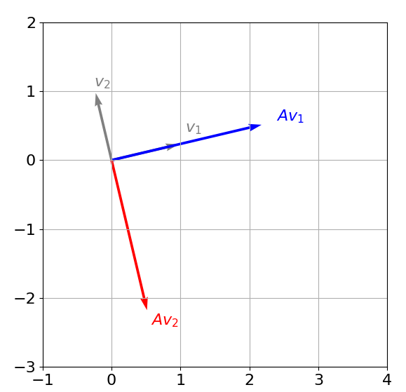
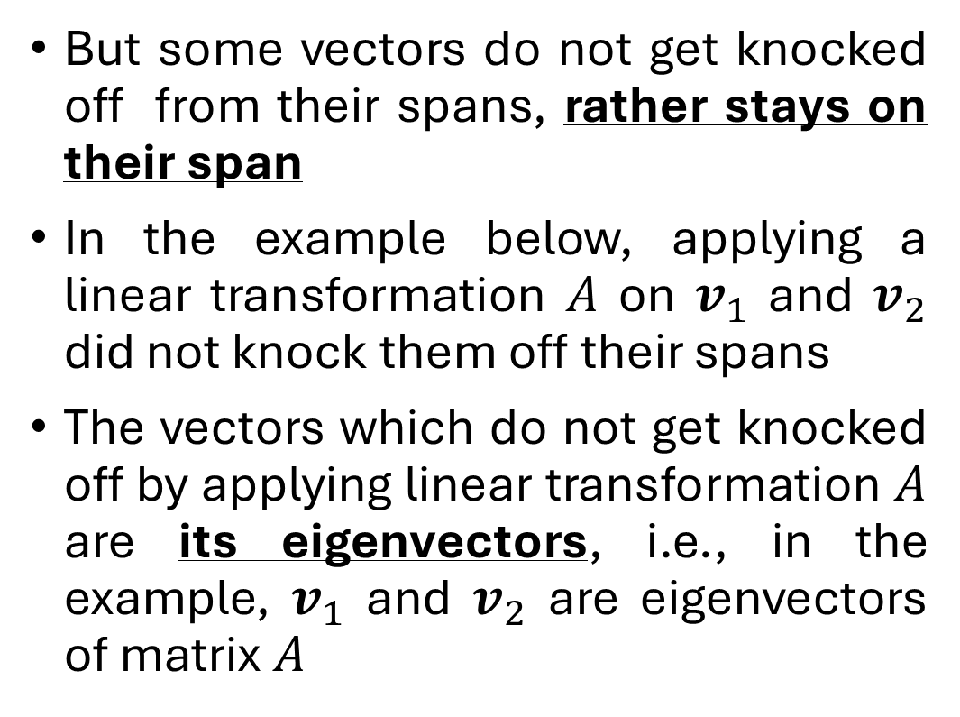
Eigenvectors and Eigenvalues
But some vectors do not get knocked off from their spans, rather stays on their span
In the example below, applying a linear transformation $A$ on $v_{1}$ and $v_{2}$ did not knock them off their spans
The vectors which do not get knocked off by applying linear transformation $A$ are its eigenvectors, i.e., in the example, $v_{1}$ and $v_{2}$ are eigenvectors of matrix $A$

Slide 10
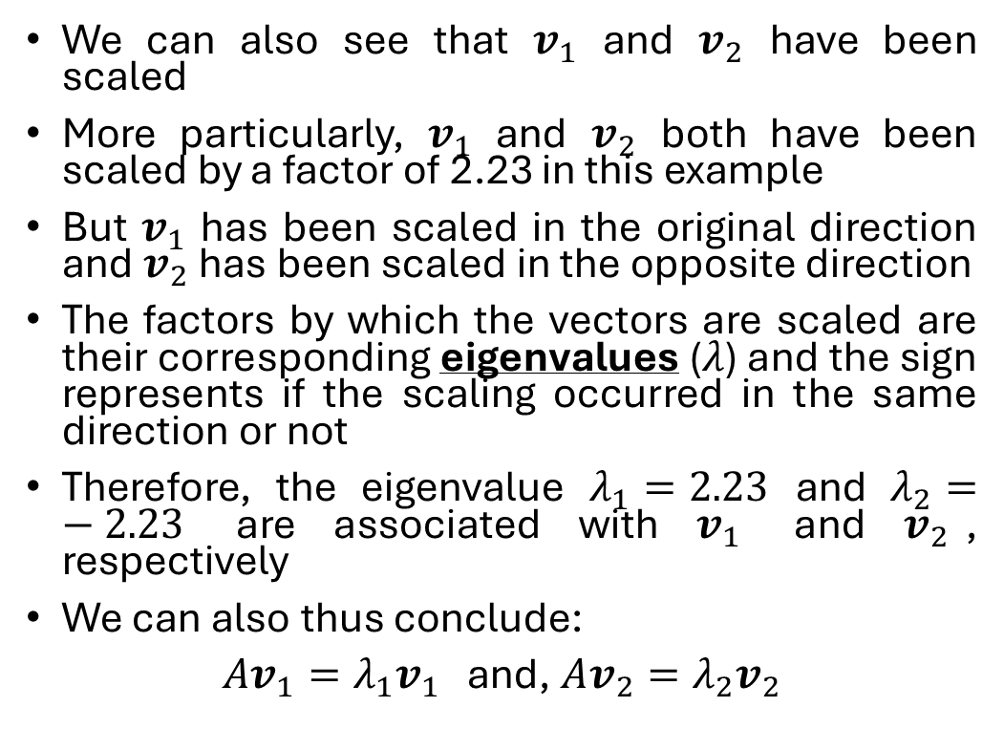
Eigenvectors and Eigenvalues (contd.)
We can also see that $v_{1}$ and $v_{2}$ have been scaled
More particularly, $v_{1}$ and $v_{2}$ both have been scaled by a factor of 2.23 in this example
But $v_{1}$ has been scaled in the original direction and $v_{2}$ has been scaled in the opposite direction
The factors by which the vectors are scaled are their corresponding eigenvalues ($λ$) and the sign represents if the scaling occurred in the same direction or not
Therefore, the eigenvalue $λ_{1}=2.23$ and $λ_{2}=−2.23$ are associated with $v_{1}$ and $v_{2}$, respectively
We can also thus conclude:
$Av_{1}=λ_{1}v_{1}$ and, $Av_{2}=λ_{2}v_{2}$

Slide 11
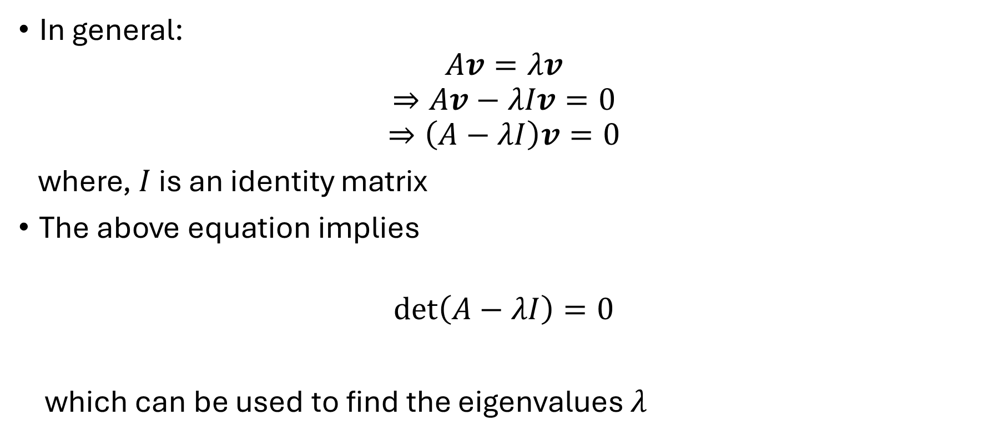
Eigenvectors and Eigenvalues (contd.)
In general:
$$Av=λv$$
$$⇒Av−λIv=0$$
$$⇒\left(A−λI\right)v=0$$
where, $I$ is an identity matrix
The above equation implies
$$\det\left(A−λI\right)=0$$
which can be used to find the eigenvalues $λ$

Slide 12

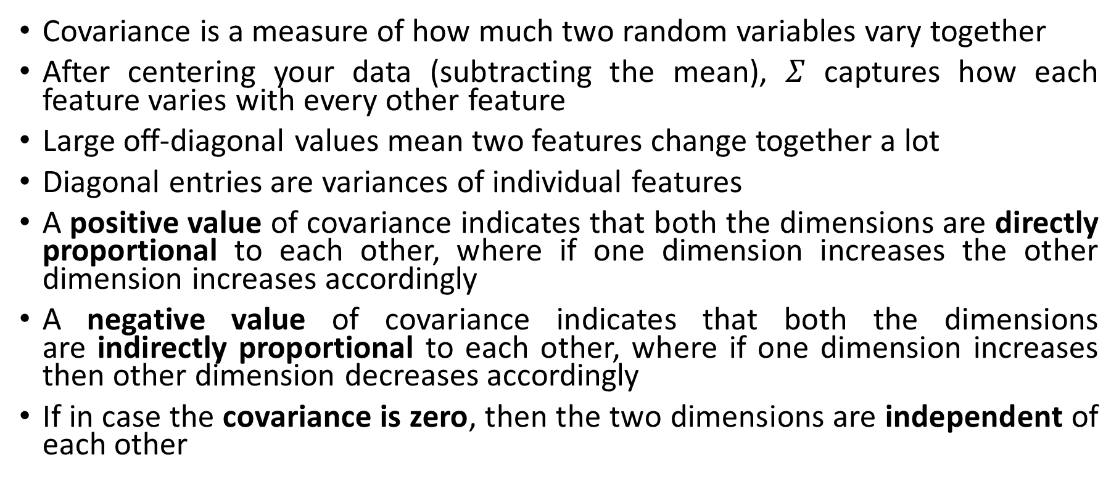
Covariance Matrix ($Σ$)
Covariance is a measure of how much two random variables vary together
After centering your data (subtracting the mean), $Σ$ captures how each feature varies with every other feature
Large off‑diagonal values mean two features change together a lot
Diagonal entries are variances of individual features
A positive value of covariance indicates that both the dimensions are directly proportional to each other, where if one dimension increases the other dimension increases accordingly
A negative value of covariance indicates that both the dimensions are indirectly proportional to each other, where if one dimension increases then other dimension decreases accordingly
If in case the covariance is zero, then the two dimensions are independent of each other

Slide 13
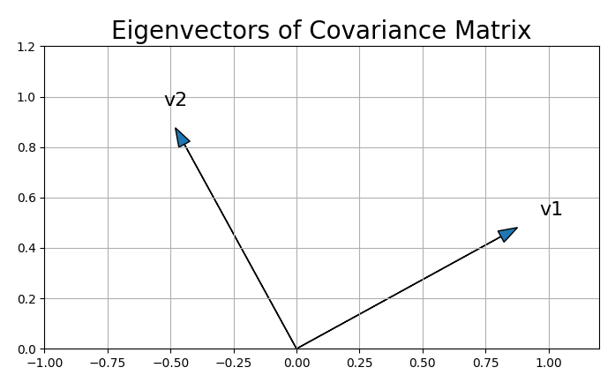
Covariance Matrix (contd.)
A covariance matrix is always symmetric, i.e., the eigenvectors of the covariance matrix are perpendicular to each other

Slide 14
Dimensionality Reduction

Slide 15
Introduction
Datasets with too many features in machine learning can lead to:
Slow computation
Overfitting (poor generalization to new data)
Dimensionality reduction is a technique used to:
Reduce the number of input features
Retain essential information
Convert data into a lower-dimensional space while preserving key details
Example:
Task: Predicting house prices using features like number of bedrooms, square footage, and location
Problem: Adding too many extra features (e.g., room condition, flooring type) can make the dataset large and complex
Solution: Use dimensionality reduction to simplify the dataset without losing important predictive power

Slide 16
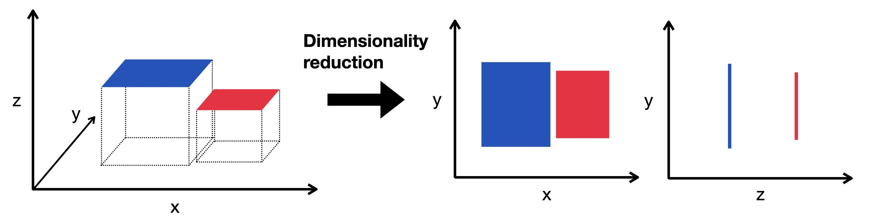
Graphical Example

Slide 17
Advantages
Faster Computation: Reducing the number of features speeds up data processing, making model training and testing more efficient – especially for large datasets
Improved Visualization: Lower-dimensional data is easier to plot (e.g., 2D or 3D), helping reveal patterns, trends, and clusters that are otherwise hard to detect
Reduced Overfitting: Fewer features reduce the model's chance of memorizing the training data, improving generalization to unseen data and enhancing prediction accuracy

Slide 18
Disadvantages
Potential Data Loss: Important information may be discarded in the process, possibly reducing model accuracy
Difficult Component Selection: Choosing the right number of dimensions to retain is challenging – too few may miss key data, while too many may retain noise and cause overfitting

Slide 19
Principal Component Analysis (PCA)

Slide 20
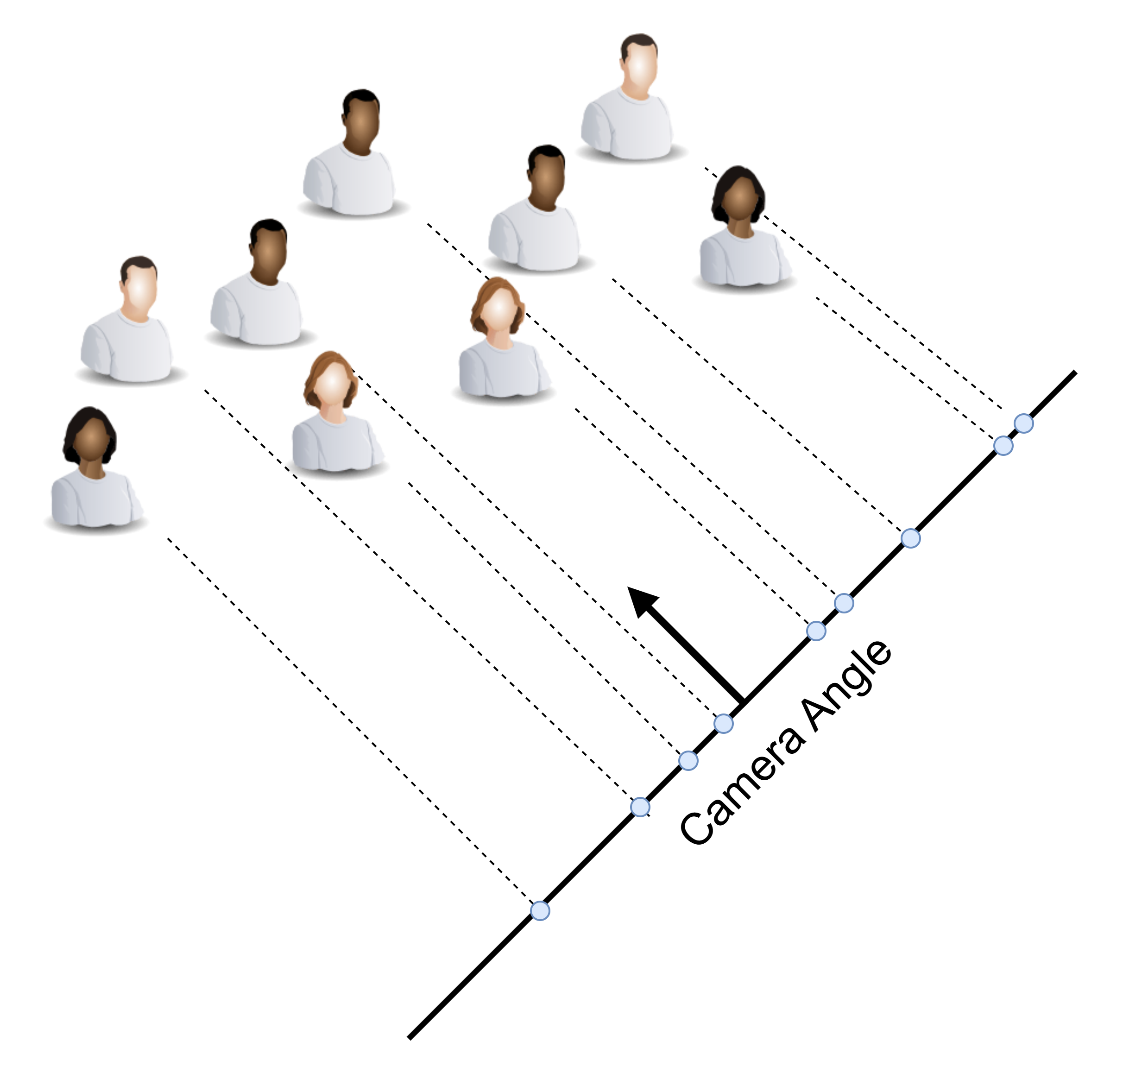
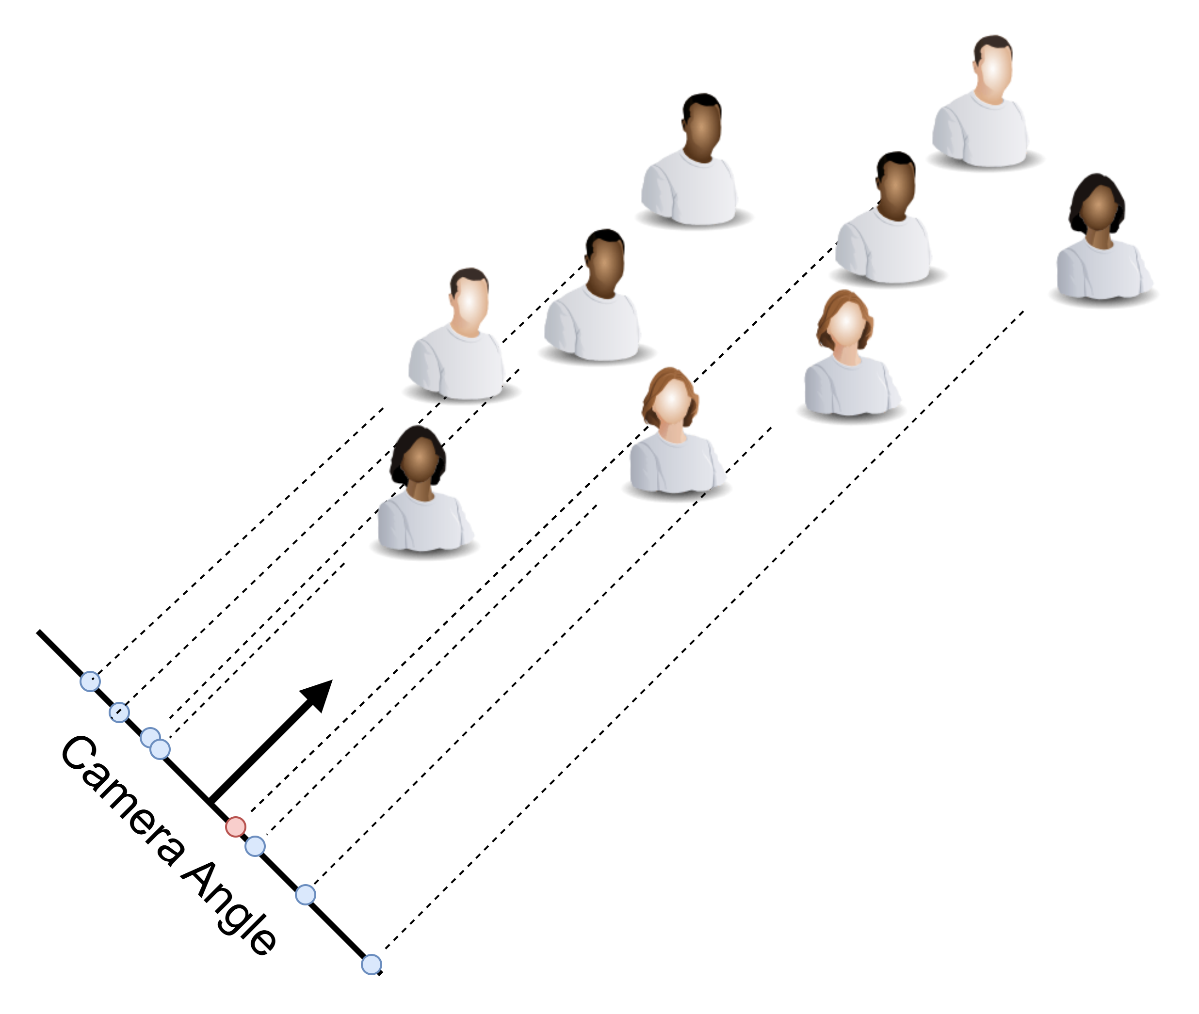
PCA: The Idea
Taking picture of a group of people from different angles
However, the picture taken on the right is capturing more details since the people when projected on the camera line are more “spread out” from each other
The picture taken on the left is capturing less details since the people when projected on the camera line are “close” to each other

Slide 21
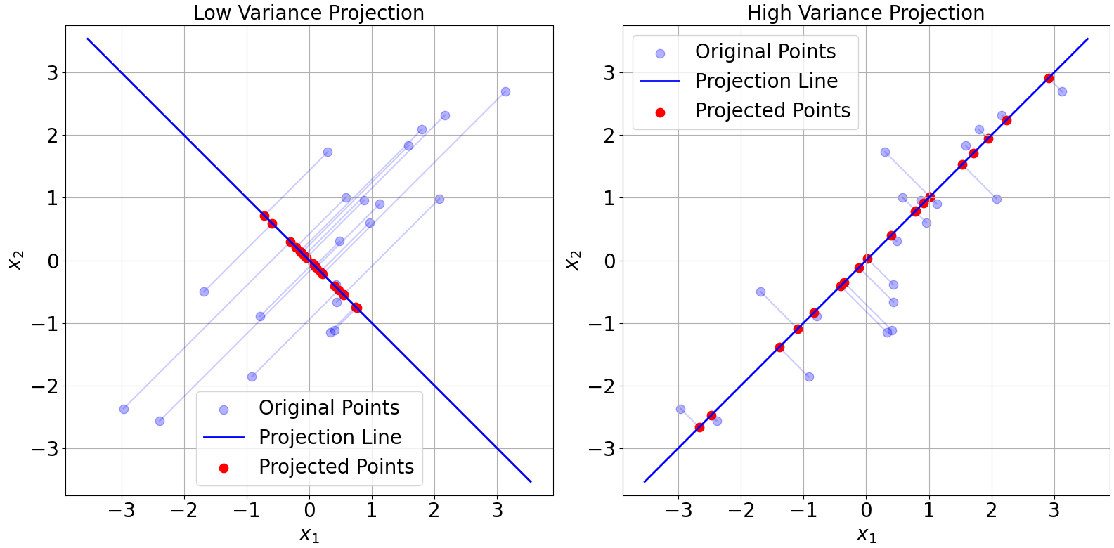
PCA: The Idea (contd.)
PCA: Taking a “picture” of your data from the optimal angle and try to keep as much information as possible in this “picture” of the data, i.e., when the data is projected onto the line, it should have high variance (more spread out)
Therefore, PCA tries to find the line that will maximize the variance

Slide 22
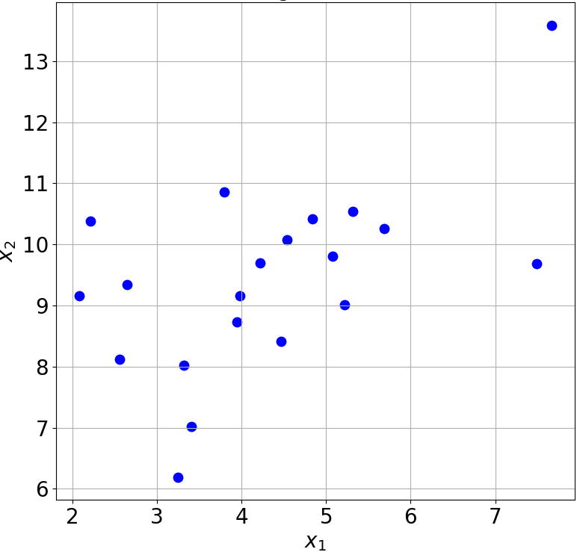
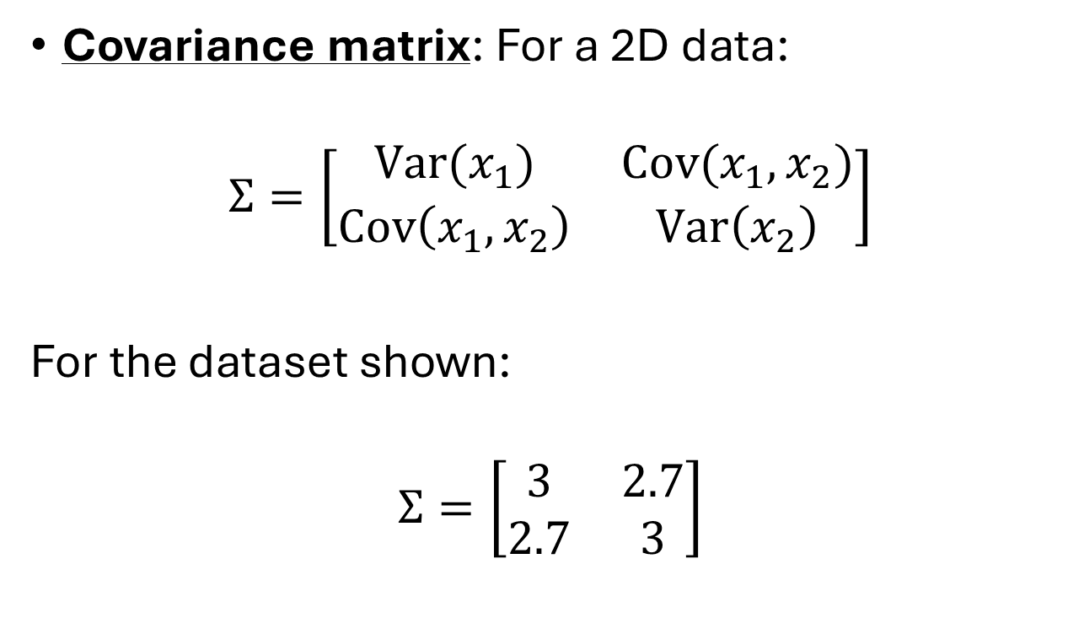
PCA: The Idea (contd.)
Covariance matrix: For a 2D data:
$$Σ=\left[\begin{matrix}Var(x_{1}) & Cov(x_{1},x_{2}) \\ Cov\left(x_{1},x_{2}\right) & Var\left(x_{2}\right)\end{matrix}\right]$$
For the dataset shown:
$$Σ=\left[\begin{matrix}3 & 2.7 \\ 2.7 & 3\end{matrix}\right]$$

Slide 23
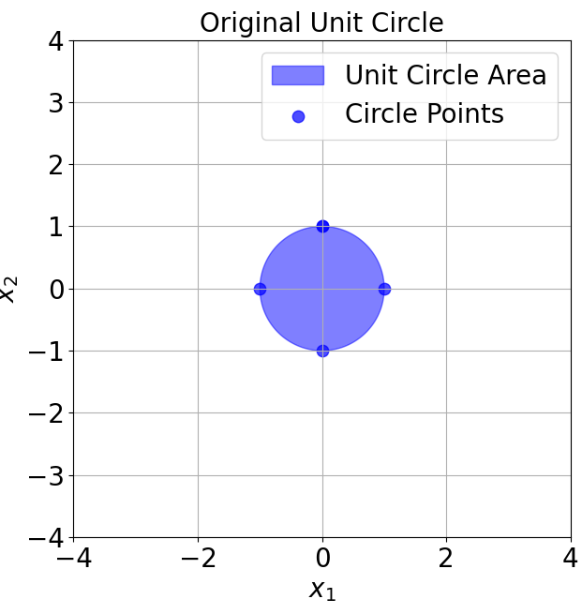
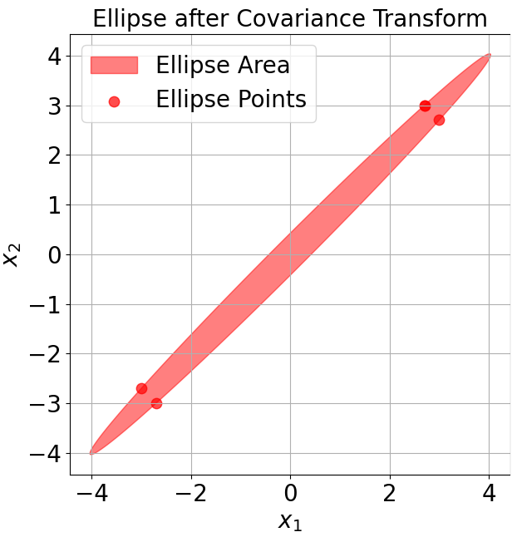

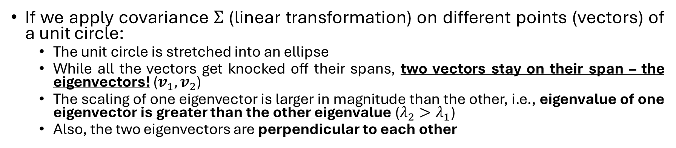




If we apply covariance $Σ$ (linear transformation) on different points (vectors) of a unit circle:
The unit circle is stretched into an ellipse
While all the vectors get knocked off their spans, two vectors stay on their span – the eigenvectors! ($v_{1},v_{2}$)
The scaling of one eigenvector is larger in magnitude than the other, i.e., eigenvalue of one eigenvector is greater than the other eigenvalue ($λ_{2}>λ_{1}$)
Also, the two eigenvectors are perpendicular to each other
$$λ_{2}v_{2}$$
$$v_{1}$$
$$v_{2}$$
$$Σ=\left[\begin{matrix}3 & 2.7 \\ 2.7 & 3\end{matrix}\right]$$
$$λ_{1}v_{1}$$

Slide 24


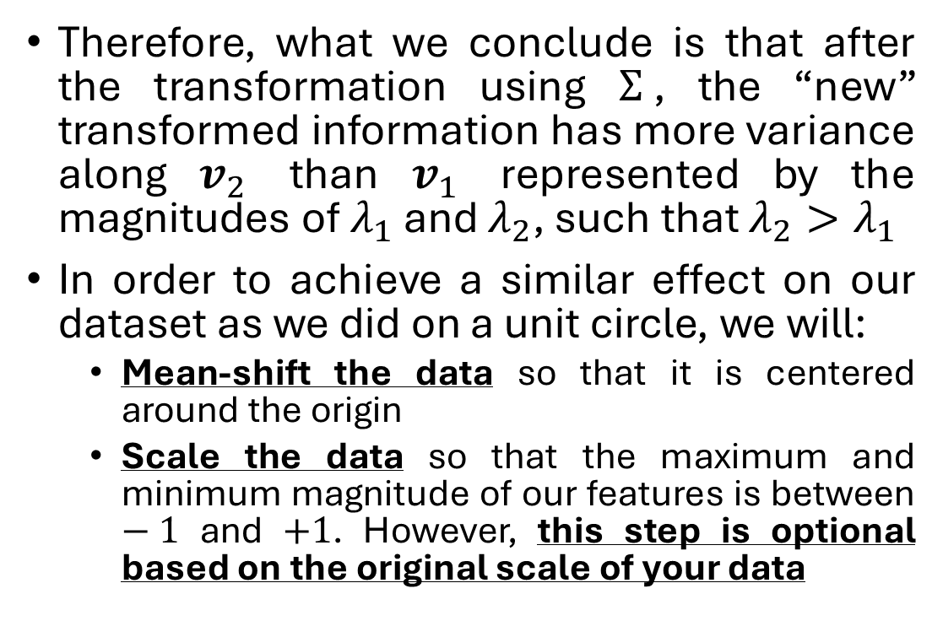
PCA: The Idea (contd.)
Therefore, what we conclude is that after the transformation using $Σ$, the “new” transformed information has more variance along $v_{2}$ than $v_{1}$ represented by the magnitudes of $λ_{1}$ and $λ_{2}$, such that $λ_{2}>λ_{1}$
In order to achieve a similar effect on our dataset as we did on a unit circle, we will:
Mean-shift the data so that it is centered around the origin
Scale the data so that the maximum and minimum magnitude of our features is between $−1$ and $+1$. However, this step is optional based on the original scale of your data
$$λ_{2}v_{2}$$
$$λ_{1}v_{1}$$

Slide 25
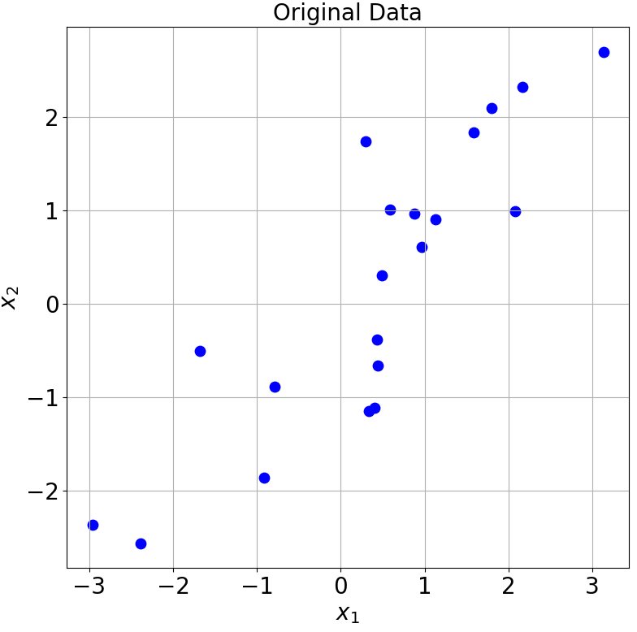
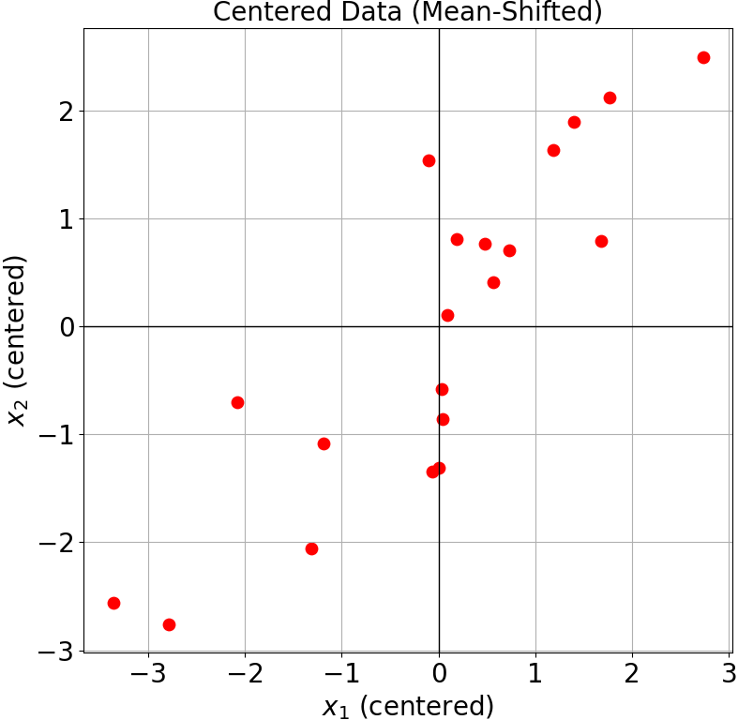
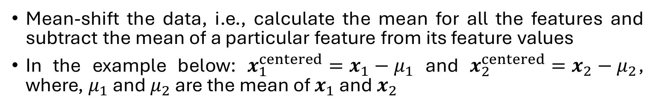
PCA: The Idea with an example
Mean-shift the data, i.e., calculate the mean for all the features and subtract the mean of a particular feature from its feature values
In the example below: $x_{1}^{centered}=x_{1}−μ_{1}$ and $x_{2}^{centered}=x_{2}−μ_{2}$, where, $μ_{1}$ and $μ_{2}$ are the mean of $x_{1}$ and $x_{2}$

Slide 26
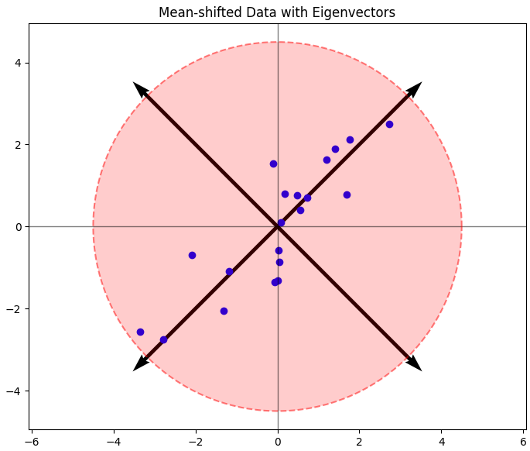
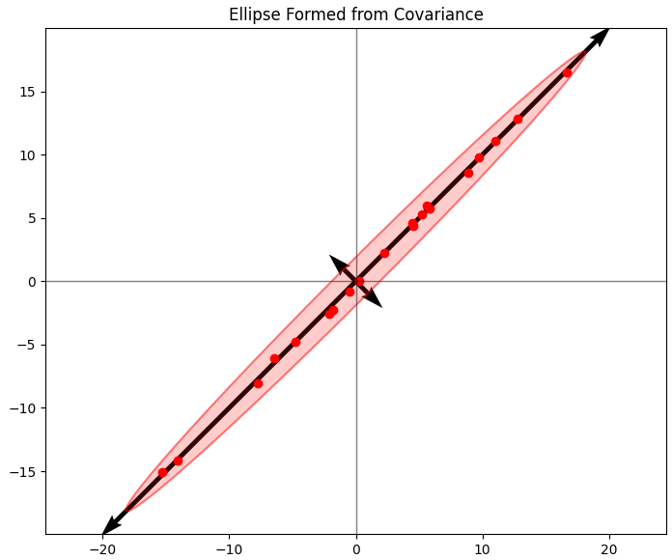

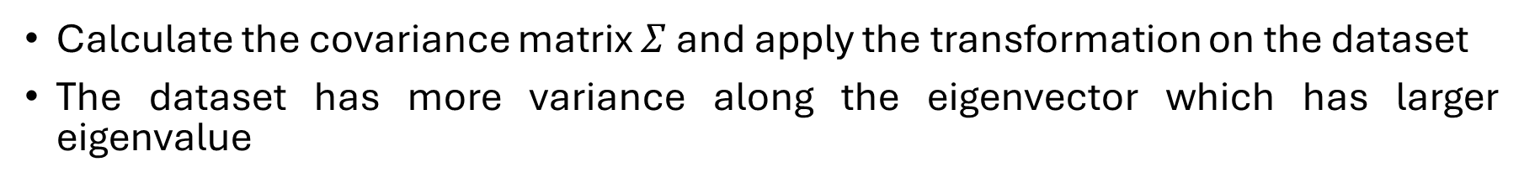
PCA: The Idea with an example (contd.)
Calculate the covariance matrix $Σ$ and apply the transformation on the dataset
The dataset has more variance along the eigenvector which has larger eigenvalue
$$Σ=\left[\begin{matrix}3 & 2.7 \\ 2.7 & 3\end{matrix}\right]$$

Slide 27
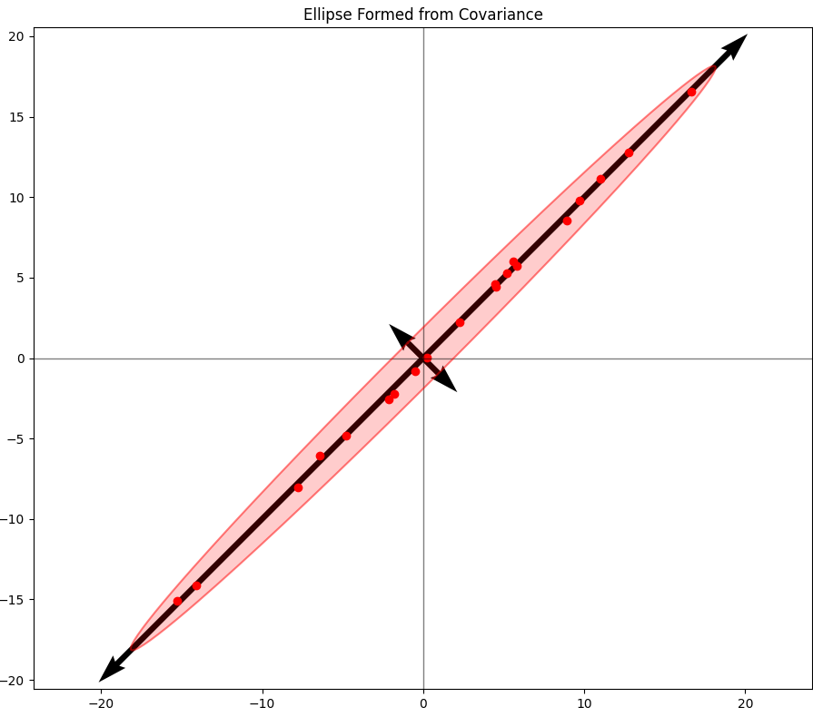
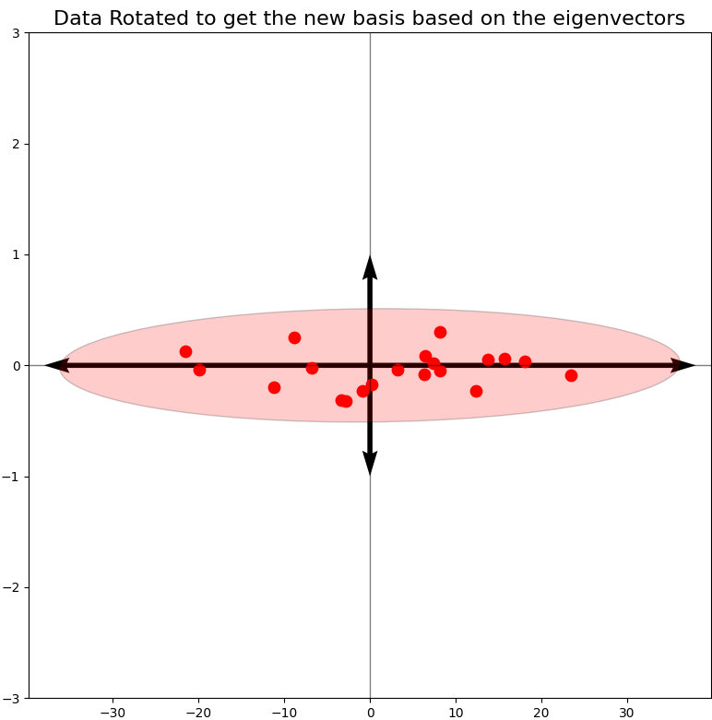
PCA: The Idea with an example (contd.)
Rotate the transformed data aligned to PC axes

Slide 28


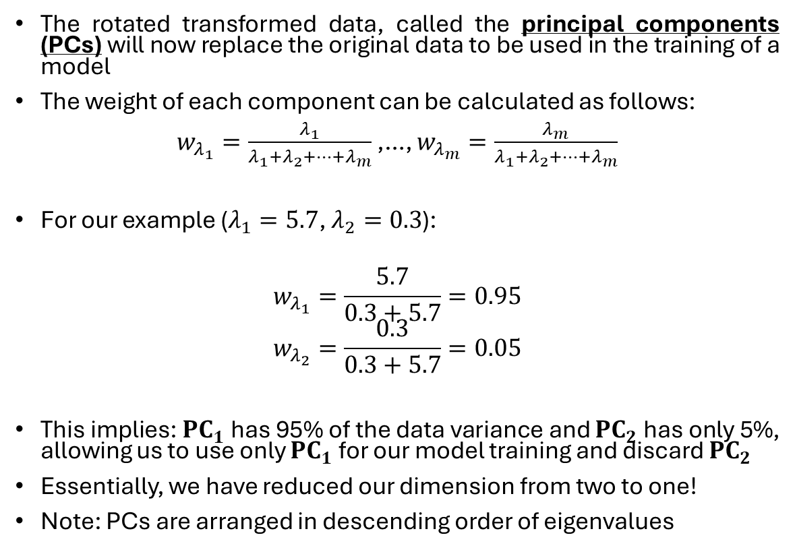
PCA: The Idea with an example (contd.)
The rotated transformed data, called the principal components (PCs) will now replace the original data to be used in the training of a model
The weight of each component can be calculated as follows:
$w_{λ_{1}}=\frac{λ_{1}}{λ_{1}+λ_{2}+…+λ_{m}}$ ,…, $w_{λ_{m}}=\frac{λ_{m}}{λ_{1}+λ_{2}+…+λ_{m}}$
For our example ($λ_{1}=5.7$, $λ_{2}=0.3$):
$$w_{λ_{1}}=\frac{5.7}{0.3+5.7}=0.95$$
$$w_{λ_{2}}=\frac{0.3}{0.3+5.7}=0.05$$
This implies: $PC_{1}$ has 95% of the data variance and $PC_{2}$ has only 5%, allowing us to use only $PC_{1}$ for our model training and discard $PC_{2}$
Essentially, we have reduced our dimension from two to one!
Note: PCs are arranged in descending order of eigenvalues
$$PC_{2}$$
$$PC_{1}$$

Slide 29
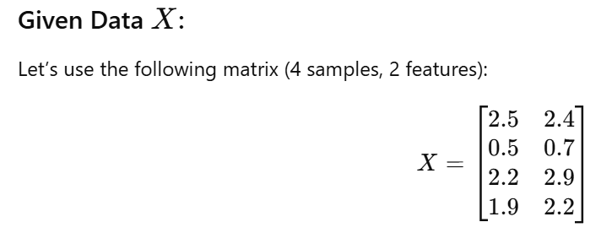
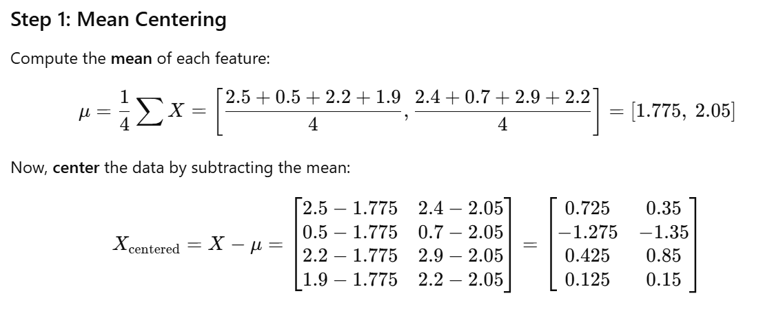
Mathematical Example

Slide 30
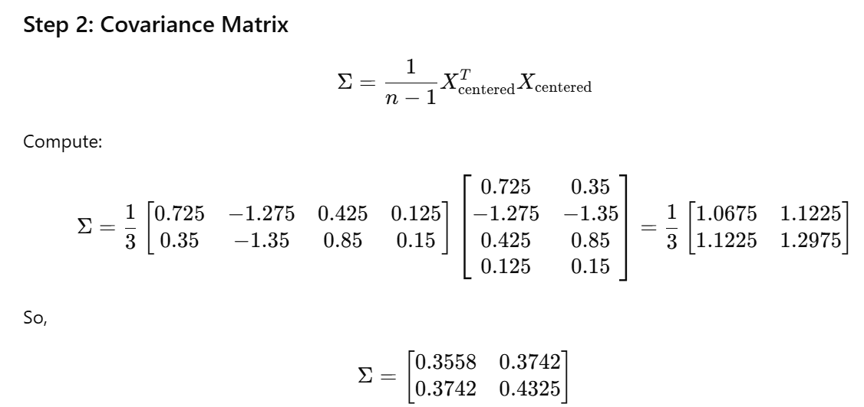
Mathematical Example (contd.)

Slide 31
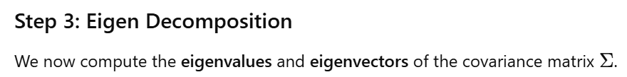
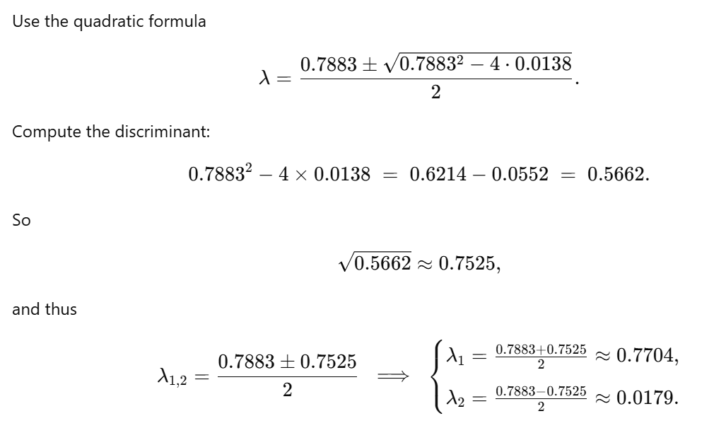
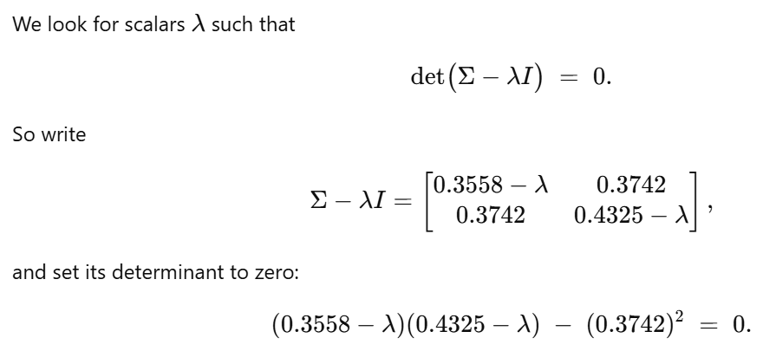

Mathematical Example (contd.)

Slide 32
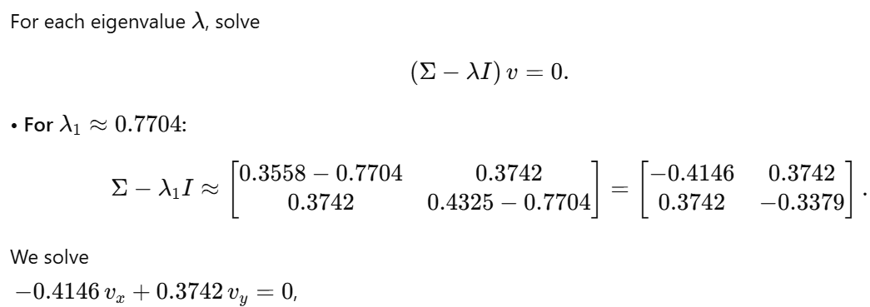
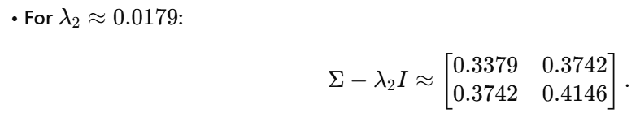

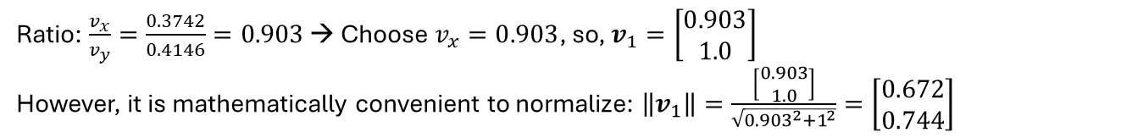
Mathematical Example (contd.)
Ratio: $\frac{v_{x}}{v_{y}}=\frac{0.3742}{0.4146}=0.903$ → Choose $v_{x}=0.903$, so, $v_{1}=\left[\begin{matrix}0.903 \\ 1.0\end{matrix}\right]$
However, it is mathematically convenient to normalize: $\left\|v_{1}\right\|=\frac{\left[\begin{matrix}0.903 \\ 1.0\end{matrix}\right]}{\sqrt{{0.903}^{2}+1^{2}}}=\left[\begin{matrix}0.672 \\ 0.744\end{matrix}\right]$
Ratio: $\frac{v_{x}}{v_{y}}=−\frac{0.3742}{0.3379}=−1.107$ → Choose $v_{x}=−1.107$, so, $v_{2}=\left[\begin{matrix}−1.107 \\ 1.0\end{matrix}\right]$, $\left\|v_{2}\right\|=\frac{\left[\begin{matrix}−1.107 \\ 1.0\end{matrix}\right]}{\sqrt{{\left(−1.107\right)}^{2}+{1.0}^{2}}}=\left[\begin{matrix}−0.742 \\ 0.671\end{matrix}\right]$

Slide 33
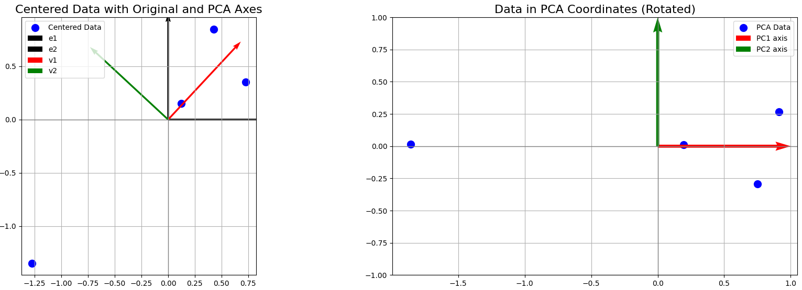
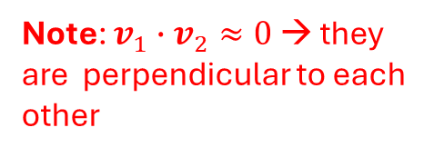
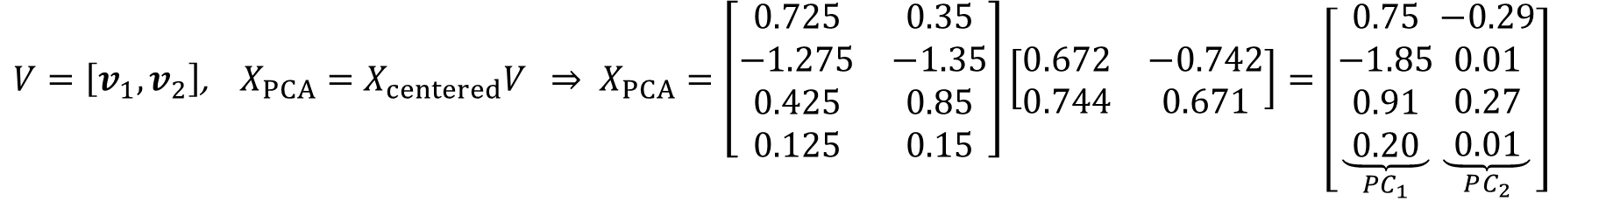
Mathematical Example (contd.)
$V=\left[v_{1},v_{2}\right]$, $X_{PCA}=X_{centered}V$ $⇒ X_{PCA}=\left[\begin{matrix}0.725 & 0.35 \\ −1.275 & −1.35 \\ 0.425 & 0.85 \\ 0.125 & 0.15\end{matrix}\right]\left[\begin{matrix}0.672 & −0.742 \\ 0.744 & 0.671\end{matrix}\right]=\left[\underset{PC_{1}}{\underbrace{\begin{matrix}0.75 \\ −1.85 \\ 0.91 \\ 0.20\end{matrix}}}\underset{PC_{2}}{\underbrace{\begin{matrix}−0.29 \\ 0.01 \\ 0.27 \\ 0.01\end{matrix}}}\right]$
Note: $v_{1}∙v_{2}≈0$ → they are perpendicular to each other
Note: The data is transformed as well as rotated directly by the eigenvectors

Slide 34
Summary (Limitations)
PCA is a linear dimensionality reduction technique
It finds directions (principal components) that maximize linear variance in the input features
PCA transforms features to principal components, which are not guaranteed to align with the most predictive features
PCA maximizes variance, not predictive power
So, it may keep components that have high variance but are less relevant for prediction
If the data lies on a nonlinear manifold (like a spiral, circle, or curved surface), PCA will:
Fail to capture the true structure of the data
Likely discard important nonlinear information

